Slide 1
Framework
Requirement analysis is an action that turns human language into SE language.

Slide 2
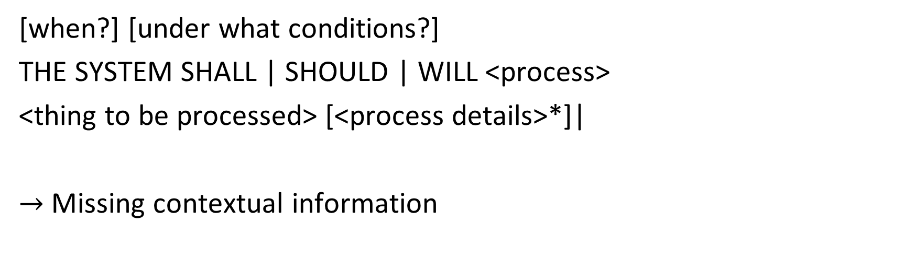
Simple requirements template
[when?] [under what conditions?]
THE SYSTEM SHALL | SHOULD | WILL <process>
<thing to be processed> [<process details>*]|
$→$ Missing contextual information

Slide 3
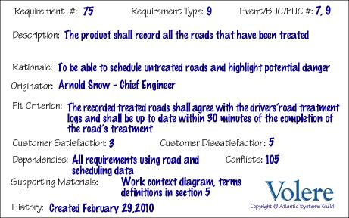
Standards
Volere template*
[*] https://www.volere.org/templates/volere-requirements-specification-template/

Slide 4
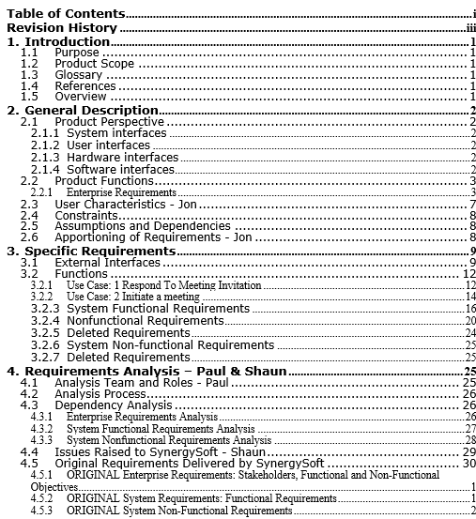
Standards
IEEE Software Requirements Specification Template 830-1998

Slide 5
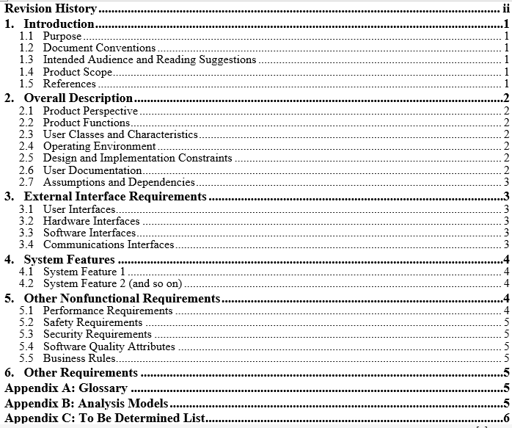
Standards
IEEE Software Requirements Specification Template 29148 – 2011.

Slide 6
Standards 29148:2011
Description: This standard replaces IEEE 830-1998, IEEE 1233-1998, IEEE 1362-1998.
- ISO/IEC/IEEE 29148:2011 contains provisions for the processes and products related to the engineering of requirements for systems and software products and services throughout the life cycle.
- We can custom this template for my own purpose [*].
[*] https://github.com/vutuanhai237/CourseMaterials/tree/master/SE357-Requirement%20engineering

Slide 7
Content
What kind of frameworks have you used?
How were they organized?
What did they provide?

Slide 8
References
[1] Birgit Penzenstadler lectures

